Slide 1

Ambulance Arrival Timing
Presented by
Muhib Hassan Khan
Md Enamul Haque Sumon

Slide 2
Acknowledgement
Dr. Scott Mann
Sameer Cooshna

Slide 3
Background
Ambulances are time critical
Every second matters in emergency
Staff availability vital
Staff preparation crucial
Traffic problem is pivotal
Needs accurate ETA
System to learn and generate ETA
Lesser error much appreciated

Slide 4
Project Idea
Build system that can generate ETA
Learn through user uploaded data
Perform analysis on the data
Compare for more accuracy
Output ETA that is most relevant
Best route and alternative routes
Continuous machine learning and improving
Generate a report

Slide 5
Project Plan - Milestones
Collect training data
Database design
Build predictive analysis model
Generate real time ETA
Build a web application
Build a display system
Generate analysis report
Go LIVE

Slide 6
Project Plan - Sprints
Sprint 1 – Collect training data and testing
Sprint 2 – Build a machine learning model
Sprint 3 – Build a predictive analysis model
Sprint 4 – Build display system and generate report
Sprint 5 – Assembly and testing
Sprint 6 - Documentation

Slide 7
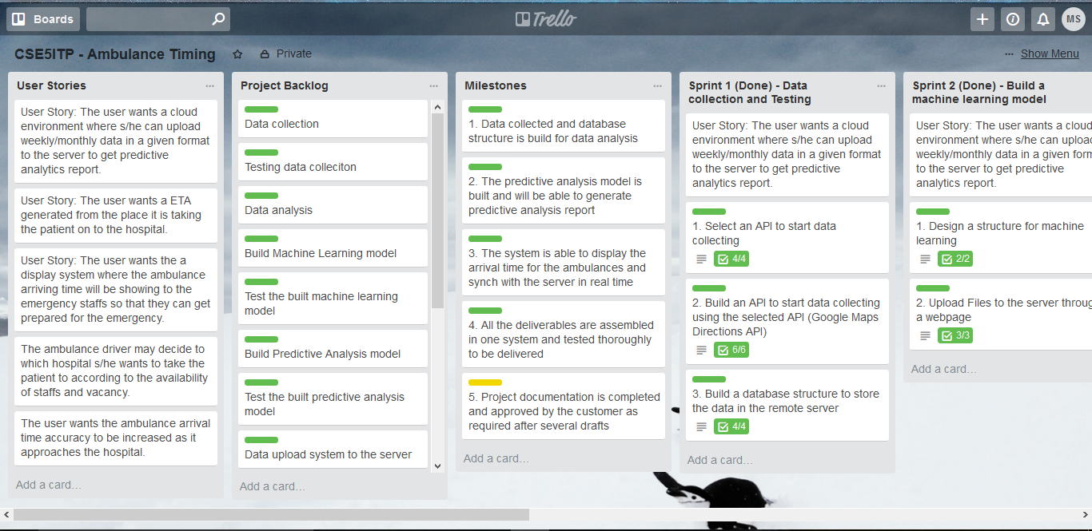
Project Plan – Sprints and Backlogs

Slide 8
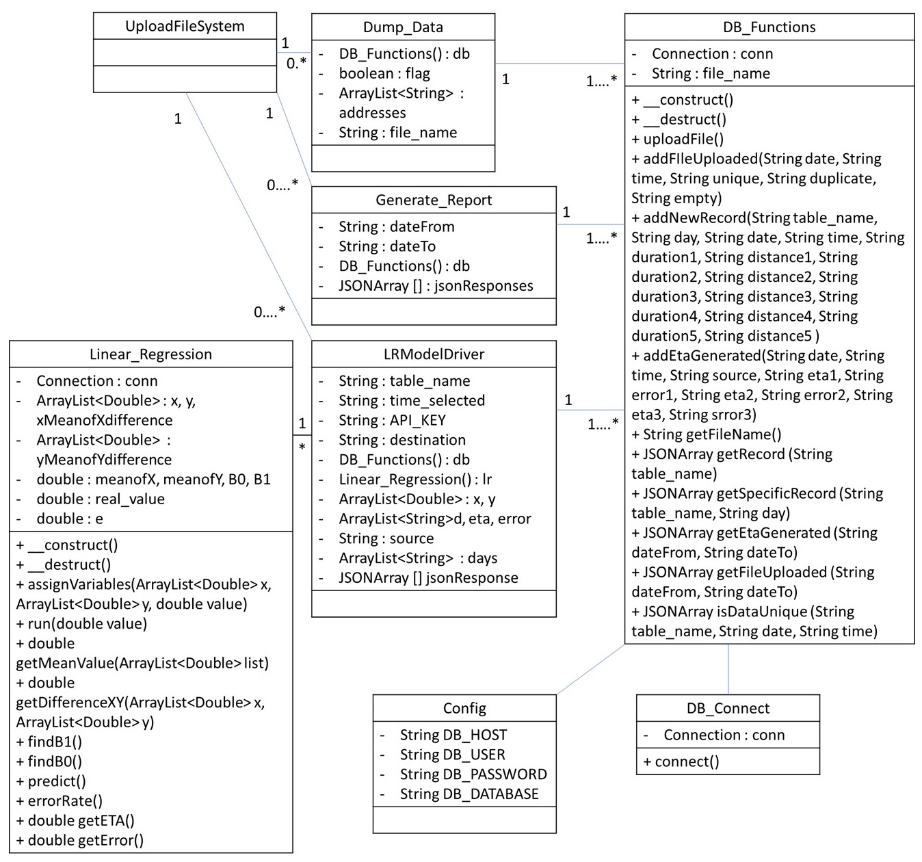
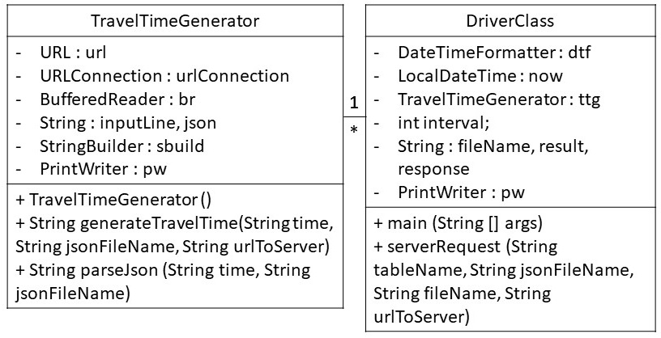
Project Plan – Class Diagram

Slide 9
Project Plan – Test Case Specifications
User web page
Login/Sign up system
File upload system
Generate ETA system
Generate report system

Slide 10
Project Plan - Tools
Platform:
Windows – client side
Linux – server side
Browser – Mozilla (preferred)
Language:
Java, PHP
Database:
SQL
IDE/Others:
Netbeans
Notepad++

Slide 11
Project Solution – Data Collection
Data is collected using Google Map API
The best route and alternative routes are recorded
Text file was used to store initial json data from Goolge Map
Json data was parsed to text file
CSV format used

Slide 12
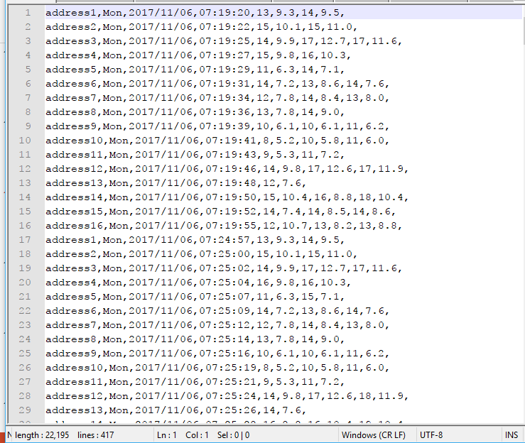
Project Solution – Data Collection contd.

Slide 13
Project Solution – Log In/Sign Up
Unique Staff ID required
Pre populated database with staff IDs
User sign up with staff ID
User choose unique username
Confirms password
Forgotten password cannot be reset by user
Only hospital administration can change password

Slide 14
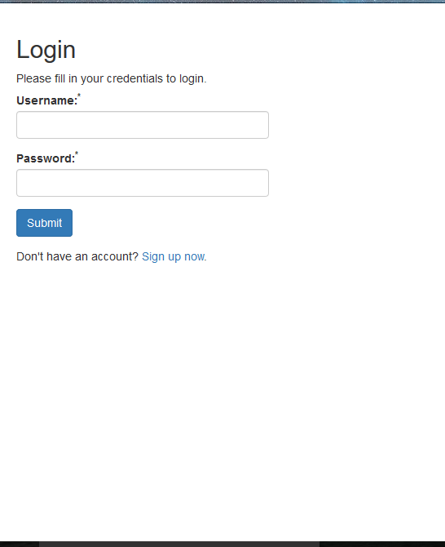
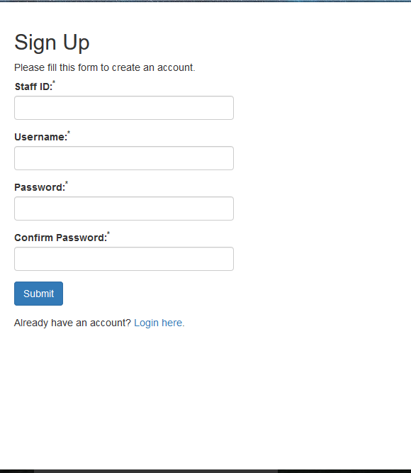
Project Solution – Log In/Sign Up contd.

Slide 15
Project Solution – File Upload
Only text files allowed in CSV* format
Only unique data is added
Unique data is checked by date and time
Duplicates can corrupt the data so strictly avoided
No empty lines can populate database
A short summery report for uploaded file will be shown
* Comma Separated Values

Slide 16
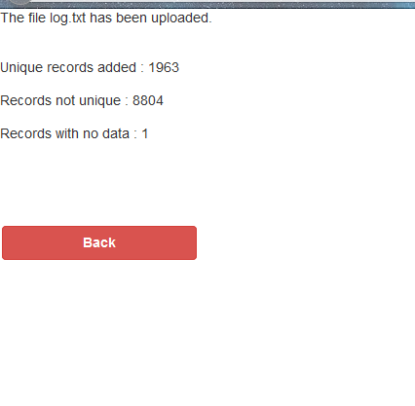
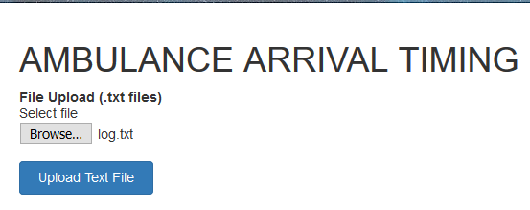
Project Solution – File Upload contd.

Slide 17
Project Solution – Generate ETA
User will select starting point
User can select if the siren/lights are on
ETA will be generated for current time
Upon user an earlier time can be chosen to generate ETA
A Google Map API will display the routes with direction
Multiple routes will be displayed
Also the system generated ETA will be displayed
Again multiple routes ETA will be generated

Slide 18
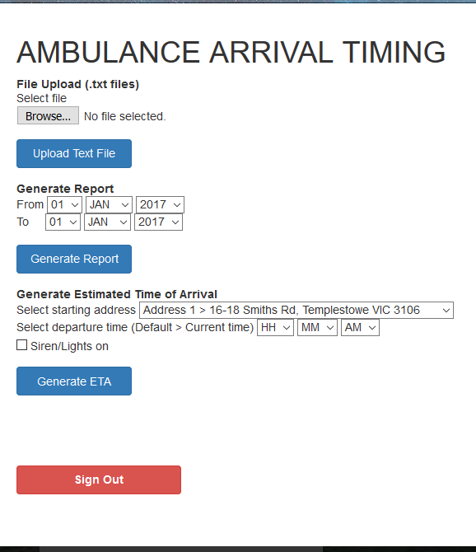
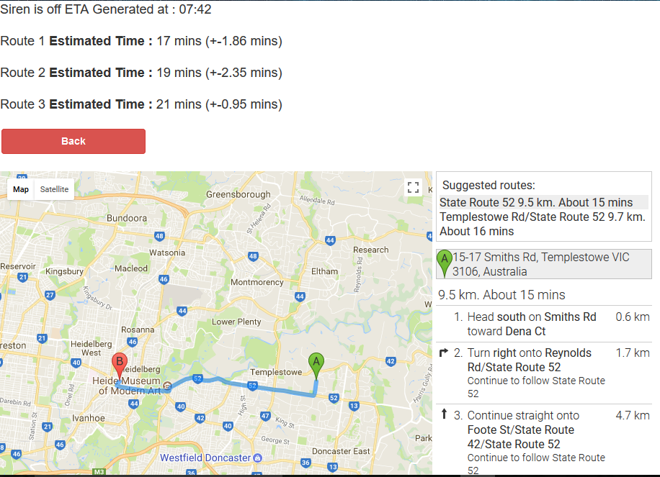
Project Solution – Generate ETA contd.

Slide 19
Project Solution – Generate Report
User chooses the date
Start date and end date
Report will be generated within that date
Report will contain
How many times a ETA was generated
ETA generation history
Data file upload history
Impact of uploaded data on the ETA
Comparison of error rate from time to time

Slide 20
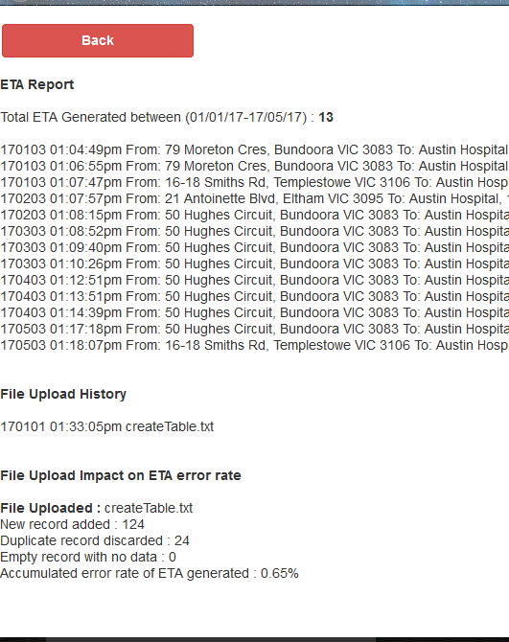

Project Solution – Generate Report contd.

Slide 21
Project Analysis
The training data was collected using Goolge Maps Direction API
30% training data was used for validation data set
Only 16 address/coordinates were selected to train and test the module
235,000+ training data were collected over two months period starting August 25, 2017
Each addresses on average have 14,500+ training data
Training data were collected in every 5 mins interval

Slide 22
Project Analysis contd.
Linear Regression model was used to generate ETA
ETA was generated using the following formula
On the given day and given time
Training_Data_Set from current time - 30 mins
To
Training_Data_Set to current time + 30 mins
This formula ensures more accuracy
The lower the range the better the accuracy
Given to limited data, an hour window was chosen

Slide 23
Project Limitations
Only accepts .txt files
Analysis model was trained with only 16 coordinates data to the hospital due to Google Maps restrictions of 2,500 requests/day
Siren/Lights on data was limited and an assumption of 20% faster ETA was made
Data is only based on Google Maps result which is for regular vehicles on the streets
More ambulance GPS data will only improve the algorithm to produce better outcome

Slide 24
Project Future Scope of Improvement
More files format will be accepted ex .xlsx, .csv, .xml, .json
Generated report will include more information
Graphs analysis
Overall performance of the algorithm
Improvement of situation using the system
Track record of every changes made by every staff
ETA will be generated for every coordinates in a given region
Using the already populated data collected from ambulances
Using real time GPS data from ambulances
Using Google Map API business key to generate more than 2,500 results/day

Slide 25
Thank You
Demonstration
QA Session

